Slide 1

Beginner Password Cracking Workshop
Presented by: DePaul's Security Daemons and National Louis University Computer Science Club

Slide 2

What is a Hash?
A hash is a one-way cryptographic function
It converts input (like a password) into a fixed-length string.
Still vulnerable if weak passwords are used.
Example
Password ➔ ef92b778bafe771e

Slide 3
Common Hashing Algorithms
Algorithm | Use Case | Secure Today?
MD5 | Legacy | No
SHA1 | Old apps | No
SHA512 | Linux | Mostly
NTLM | Windows | Weak
bcrypt | Web Apps | Yes

Slide 4
Salting and Ke y Stretching
A "salt" adds random letters to the start of your password so before hashing so the password will be unique each time.
Prevents the use of hashing tables
"Stretching" applies hashing multiple times. (5000+ rounds)

Slide 5
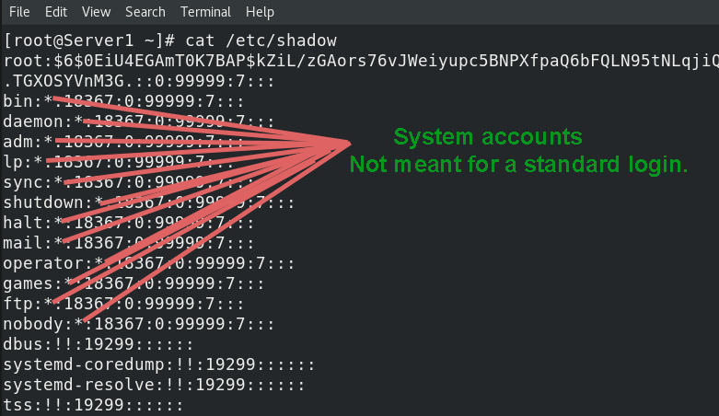
Linux Passwords
Think of Linux password hashes like vaults hidden in the basement of a server, and only those who have root keys can open it.
These hashes are stored in
/etc/shadow

Slide 6
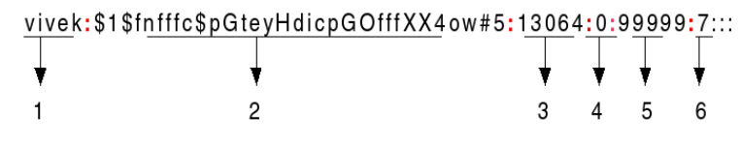
Format of /etc/shadow
Username: An account name, which exists on the system
Password: The encrypted password is in a hash format. The hash format is set $id$salt$hashed
The $id is the prefix for the hash
$1$ is MD5
$5$ is SHA-256
$6$ is SHA-512

Slide 7
Format of /etc/shadow
3. Last password change: The date of the last password change expressed in the number of days since Jan 1, 1970
4. Minimum: The minimum number of days required between password changes. It is the number of days left before the user is allowed to change their password again.
5. Maximum: The maximum number of days the password is valid
6. Warn: The number of days before password is to expire that user is warned that their password must change.

Slide 8
What is the "salt" in a hash
analyst:$6$Kb5RjUXd$G2YZ0q3bPqsd8QJcTExampleHash
$6$ = Hash type SHA-512
Kb5RjUXd = the salt to make the hash unique. It uses a cryptographically secure random number generator (CSPRNG)
G2YZ0q3bPqsd8QJcTExampleHash = The actual password which mixes with the salt
Fun Fact: If two users have the same password but different salts, their hashes will look completely different.

Slide 9
Windows Passwords
Windows stores passwords like sticky notes on a locked cabinet. The operating system tries to lock you out of that room but once you are in you can view the hashes.
LM | NTLM
aad3b435b51404eeaad3b435b51404ee | 32ed87bdb5fdc5e9cba88547376818d4
Windows has not used LM hashes for years | Used in every modern Windows machine
Not secure and outdated | Based on MD4, and ancient hashing algorithm from the 90's

Slide 10
NTLM Hashes are Goldmines for Hackers
No Salt – same hash across multiple machines
01
Fast – a modern-day GPU can guess billions of passwords a second
02
Reversable – With a big enough word list, cracking it should be no problem.
03

Slide 11
Where is the SAM file?
%SystemRoot%\System32\config\SAM
Cannot access while system is running
Tools like metasploit hashdump module can dump hashes from memory

Slide 12
Compare the Two
Which has looks more secure and which ones is MD4 (Windows) and SHA-512 (Linux no salt)
MD 4
SHA-512
b6c7a23a344007f4595a2b98bc5751e0
ba07c70d916ac64242d9591deece723ceca3c377561569bc9e69fd223de5b3587589fbc967329e688ff26b16d25659e7357b109645bd7d54ff546149dff86075
Yougotthepassword!

Slide 13
How Attackers Steal Hashes
Gain system/root access.
1
Dump or read hashes
2
Transfer them for offline cracking
3
Use those crednetials for another attack (replay attack, lateral movement)
4

Slide 14
How Password Cracking Works
Not magic: we guess passwords and hash them
Compare against the stolen hash
It matches then the password is found
Rockyou.txt
bed4efa1d4fdbd954bd3705d6a2a78270ec9a52ecfbfb010c61862af5c76af1761ffeb1aef6aca1bf5d02b3781aa854fabd2b69c790de74e17ecfec3cb6ac4bf
Run program to find the hash to the password
password
password1
password123

Slide 15
Cracking Techniques
Technique | Description
Dictionary Attack | Wordlist or common passwords
Brute Force | All combinations of letters, numbers and special characters
Hybrid | Wordlist + rules (pass123)
Rainbow Table | Precomputed Hashes

Slide 16
Tools of The Trade
Hashcat
Lightning-fast GPU-based password cracker
Supports 300+ hash algorithms (MD5, NTLM, bcrypt, etc.)
Example: hashcat -m 1000 ntlm.txt rockyou.txt
Ideal for offline hash cracking at scale
Hydra
Brute-force tool for online services (SSH, FTP, HTTP login)
Tests passwords over the network
Example: hydra -l admin -P rockyou.txt ssh://192.168.56.11
Useful for service-based attack scenarios
John the Ripper- Flexable CPU based tool
Flexible CPU-based cracking tool
Works well for Unix-style hashes, zip files, and custom formats
Example: john --wordlist=rockyou.txt shadow.txt
Great for CTFs and smaller cracking tasks

Slide 17
How to use hashcat
# Crack NTLM (Windows) hash with a wordlist
hashcat -m 1000 -a 0 ntlm_hash.txt rockyou.txt
# Crack SHA-512 (Linux /etc/shadow) hash with a wordlist
hashcat -m 1800 -a 0 shadow_hash.txt rockyou.txt
# Show supported hash modes
hashcat -h | grep Hash
# Restore a previous cracking session
hashcat --restore
# Benchmark your system’s cracking speed
hashcat -b
# Crack hashes using brute force (A-Z, a-z, 0-9, symbols)
hashcat -m 1000 -a 3 hash.txt ?a?b?2?a!a?9
# Save cracked passwords to file
hashcat -m 1800 -a 0 shadow_hash.txt rockyou.txt --outfile=cracked.txt

Slide 18

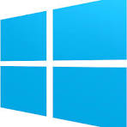
What You Will Be Doing Today
Password Recovery from SHA-256 Hash
Cracking Microsoft Office Passwords
Wifi Cracking
More to come next year!

